Slide 1
AuraDB Knowledge Graph Creation
Emīlija Kalniņa
Digital Humanities

Slide 2
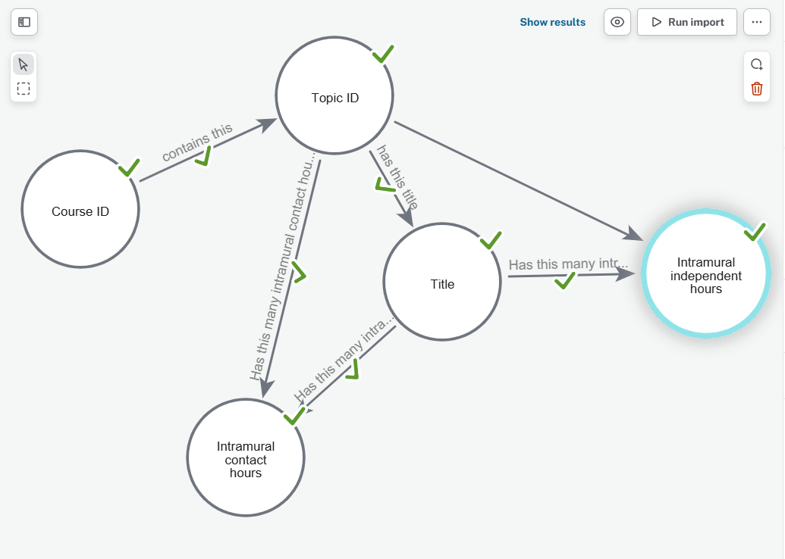
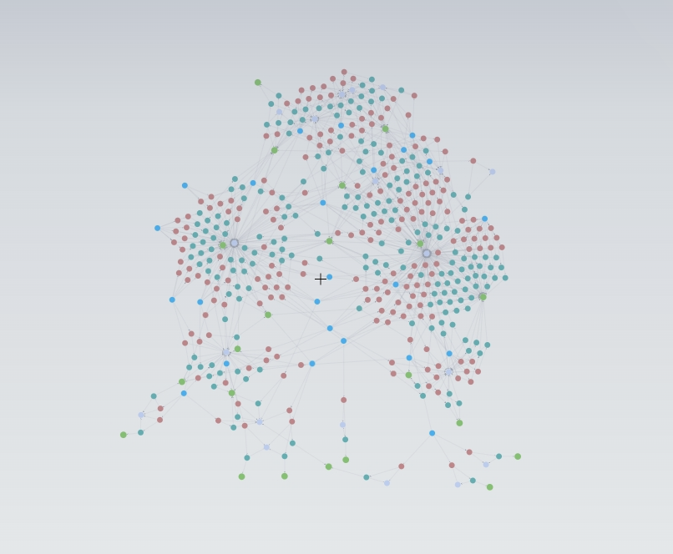
Creating schema from nodes_course_topics.csv file

Slide 3
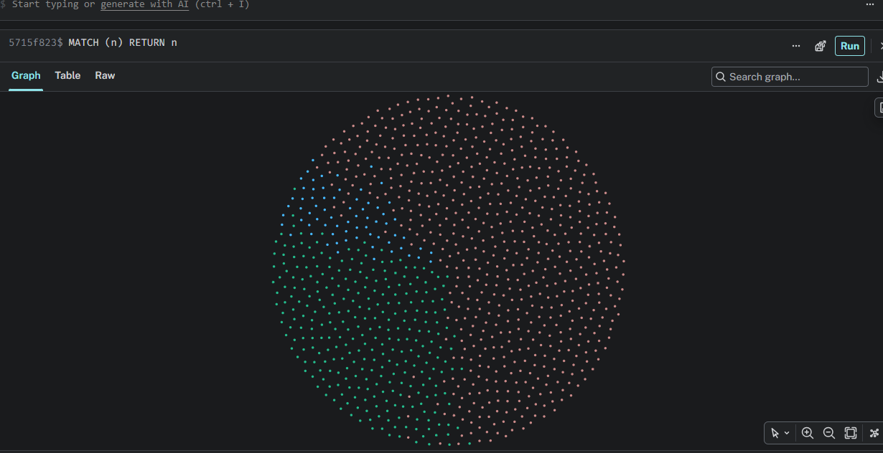
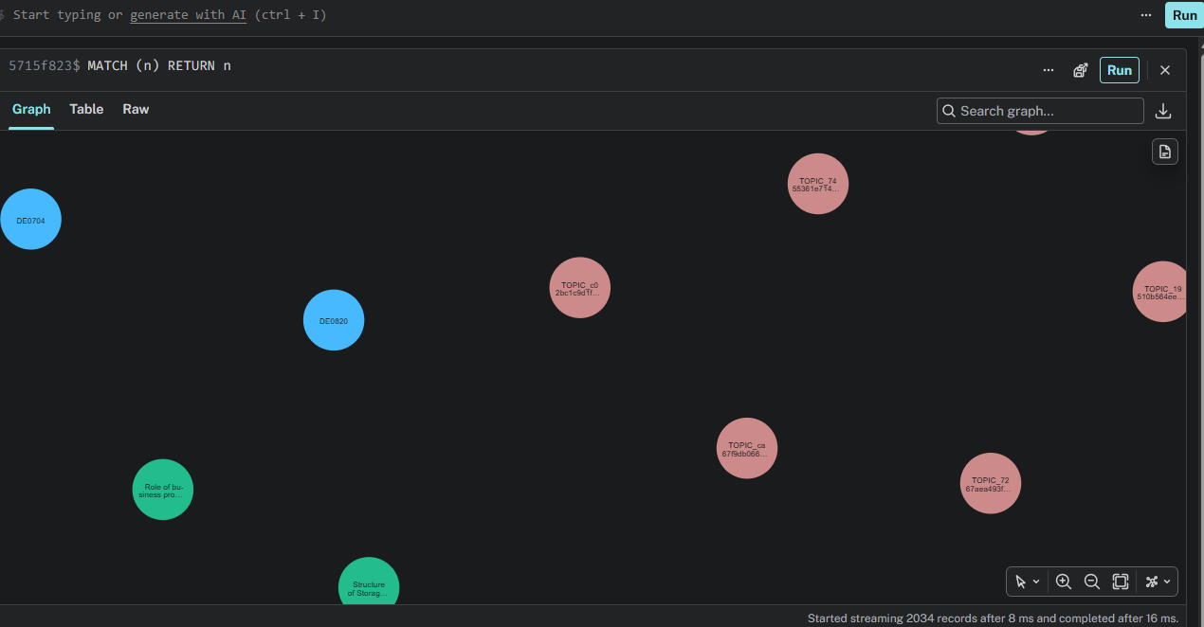
Query MATCH (n) RETURN n

Slide 4
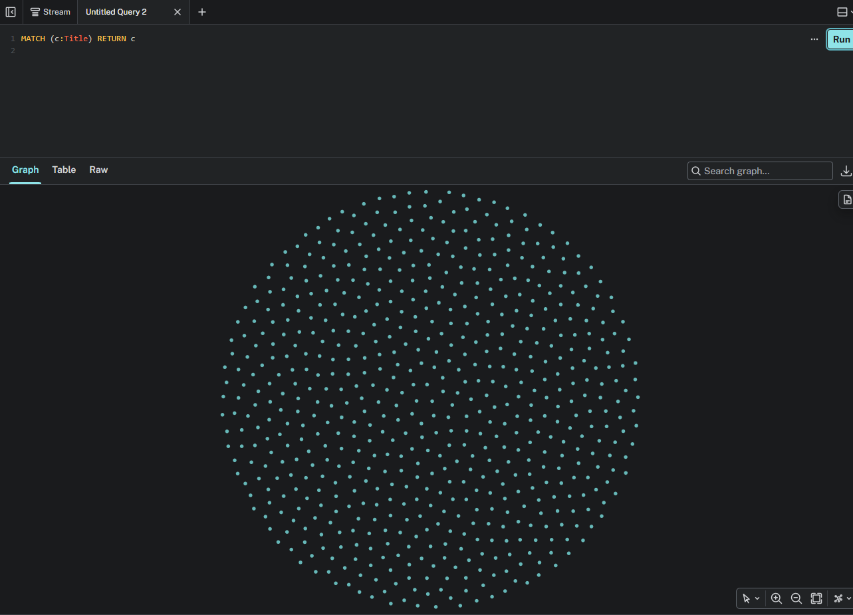
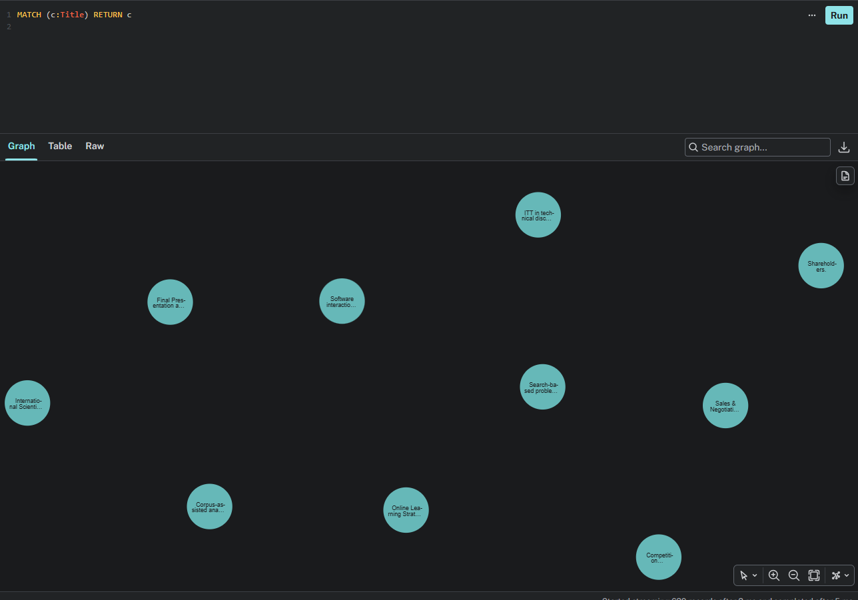
Query MATCH (c:Title) RETURN c

Slide 5
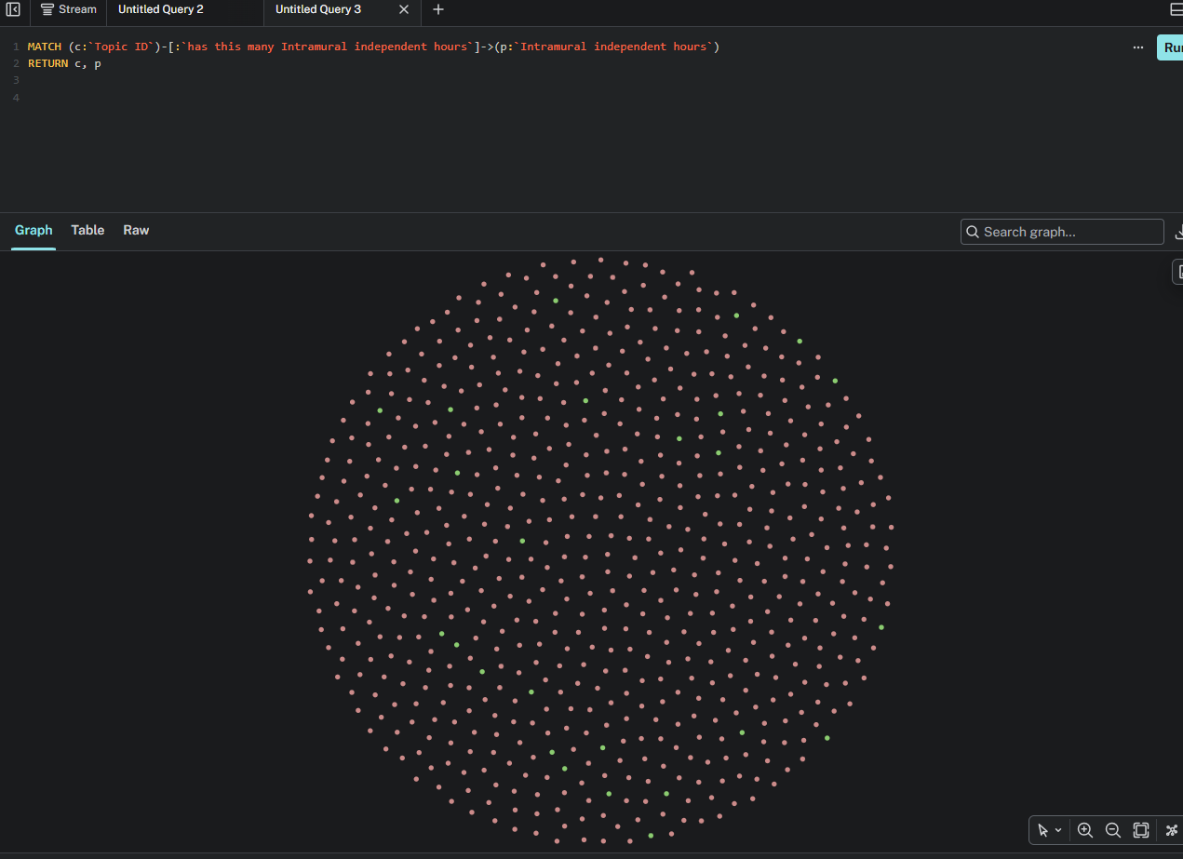
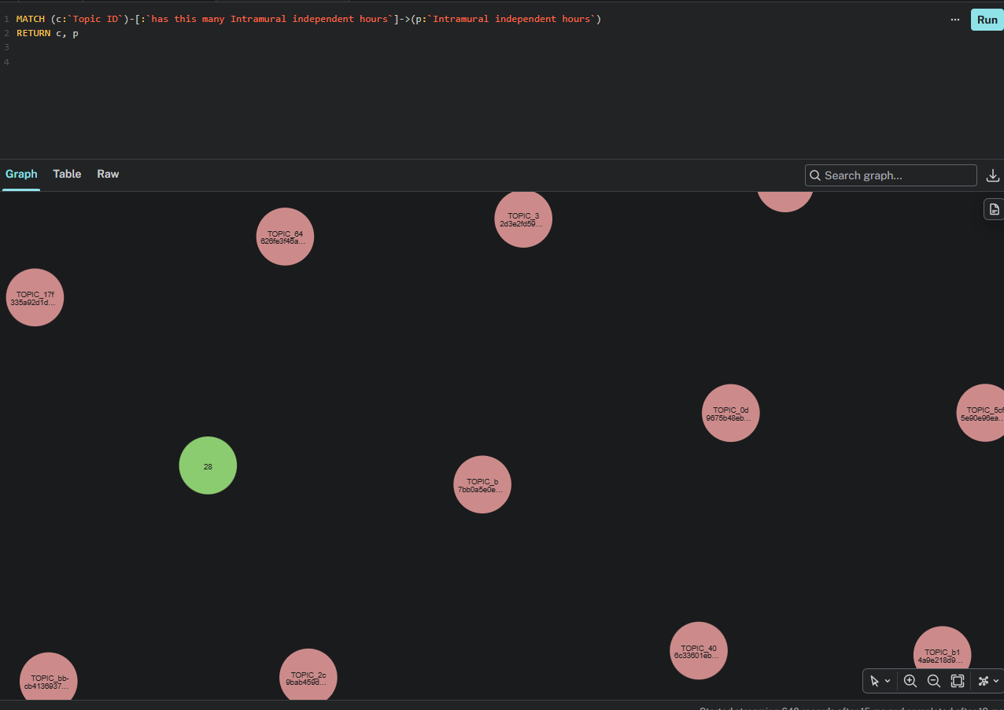
Query MATCH (c:`Topic ID`)-[:`has this many intramural independent hours`]->(p: `intramural independent hours`)
RETURN c, p

